Slide 1

Power-efficient Approximate Multiplier
via Clock-gating
Name of Faculty in charges(s) -
Name – Bibhu Asish Panda
SIC – 22bece02
Semester – 8th
DR. Lopamudra Das
Mr. Satyabrata Das
Department of Electronics & Communication Engineering,
Silicon University, Odisha
Bhubaneswar - 751024
January - 26

Slide 2

Contents
Introduction
Literature Survey
Problem Statement
Methodology
Result Analysis
Conclusions
Future Scope
References

Slide 3
Introduction
Digital multipliers are key blocks in VLSI, widely used in Digital signal processing, image processing, communication, and machine learning.
In embedded processors, multiplication consumes high power, area, and causes delay due to long adder chains and switching.
Exact multipliers give accurate results but require complex, power-hungry hardware. Modern applications like multimedia and signal processing are error-tolerant, so small inaccuracies are acceptable.
This drives the design of low-power multipliers using approximate computing and power reduction techniques.
Need for Low-Power Multiplier Design:
In synchronous circuits, much power is wasted by the clock network due to constant toggling. Conventional designs emphasize speed and accuracy, often neglecting power efficiency.
Clock gating saves energy by turning off the clock in idle blocks, reducing switching.
Approximate computing lowers hardware complexity by relaxing exact calculations, cutting power and area.
Together, clock gating and approximate arithmetic enable energy‑efficient multipliers for modern error‑tolerant applications.

Slide 4
Literature Survey
Sl. No | Title | Author(s) | Year | Contribution | Future Research Direction
1 | Digital Integrated Circuits – A Design Perspective | J. Rabaey et al. | 1995 | Analyzed RCA, CSA, CSLA, and COSA architectures in terms of delay, area, and power. | Low-power integration of advanced adder architectures.
2 | Power Aware Design Methodologies | M. Pedram et al. | 2002 | Introduced clock gating to reduce dynamic power and switching activity. | Combining clock gating with approximate arithmetic units.
3 | CMOS VLSI Design: A Circuits and Systems Perspective | N. Weste, D. Harris | 2010 | Explained VLSI design trade-offs in arithmetic circuits. | Energy-efficient arithmetic units for Digital image and signal processing and embedded systems.
4 | A Survey of Techniques for Approximate Computing | S. Mittal | 2016 | Reviewed approximate adders and multipliers focusing on power–accuracy trade-offs. | Adaptive and application-aware approximation techniques.
5 | Design of Clock-Gated Approximate Multipliers for Power Efficient Applications | V. Chowdam et al. | 2025 | Presented approximate multipliers with clock gating to reduce power and hardware overhead. | Extension to higher bit-widths and ASIC-based implementation.

Slide 5
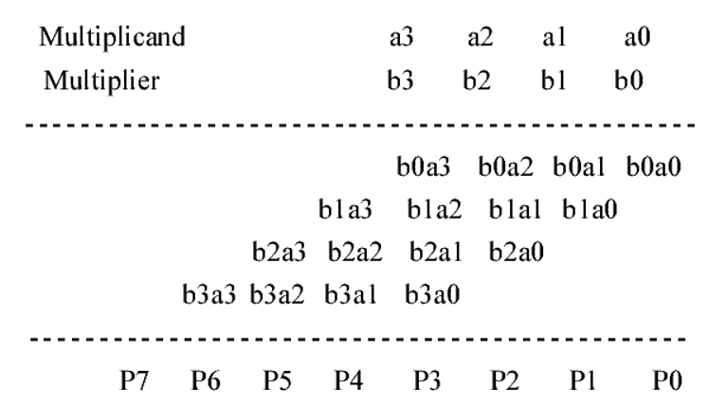
Problem Statement
Conventional exact multipliers require large hardware resources due to complex adder structures and full-precision computation.
Continuous clock toggling in synchronous circuits leads to high dynamic power consumption, even when some parts of the circuit remain idle.
Existing approximate multiplier designs mainly focus on reducing arithmetic complexity but do not effectively address clock power reduction.
Low-power techniques such as clock gating and approximation are usually applied separately rather than in a unified design framework.
There is a need for a multiplier architecture that combines approximate computing with clock gating to achieve significant power savings while maintaining acceptable accuracy.
Fig 1. Standard multiplication

Slide 6
Design Methodologies
Sub-Circuits: Types of Adders, Exact vs Approximate Circuits, Clock-gating & Multipliers and the entire clock-gated approximate multiplier

Slide 7
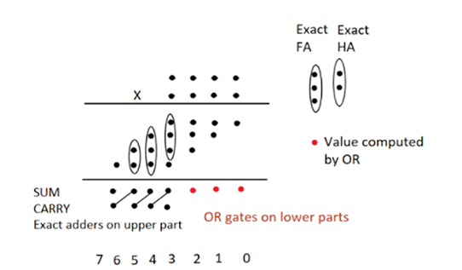
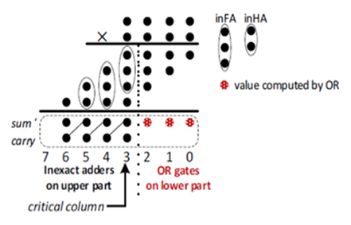
Methodology – design overview
A power-efficient multiplier architecture is designed by integrating approximate computing with clock gating techniques.
Approximate Half Adders (AHA) and Approximate Full Adders (AFA) are developed to reduce hardware complexity in the least significant bit region.
Four different adder architectures—RCA, CSA, CSLA, and COSA—are used to construct multiplier structures for performance comparison.
Clock gating logic is introduced to disable inactive adder modules and minimize unnecessary switching activity.
The complete design and functional verification are carried out using Verilog HDL.
Fig 2. Multiplication using Exact-adders
Fig 3. Multiplication using Approx-adders

Slide 8
Sub-circuits – approximate adders
Exact HA → SUM = (A ⊕ B) &
CARRY = A · B
Approx. HA → SUM = (A + B) &
CARRY = A · B
In exact half adders, ⊕ → XOR logic is used for SUM, but in approx. design it is replaced with (·) → OR logic to simplify circuitry along with (+) → AND logic.
Exact FA → SUM = (A ⊕ B ⊕ Cin) &
CARRY = (A · B) + (Cin · (A ⊕ B))
Approx. FA → CARRY = (A + B + Cin) &
SUM = (CARRY)’
Carry generation logic is intentionally simplified to reduce the number of gates and internal switching transitions.
Approximate adders are used in the LSB region of the multiplier, while exact adders are retained in the MSB region to preserve overall accuracy.

Slide 9
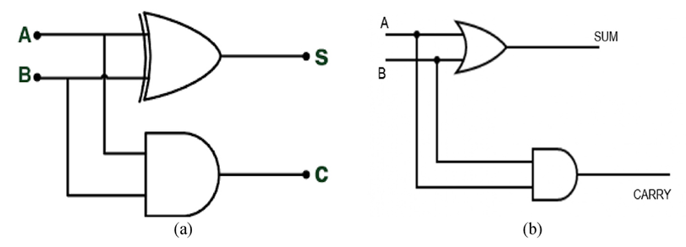
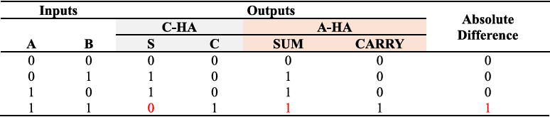
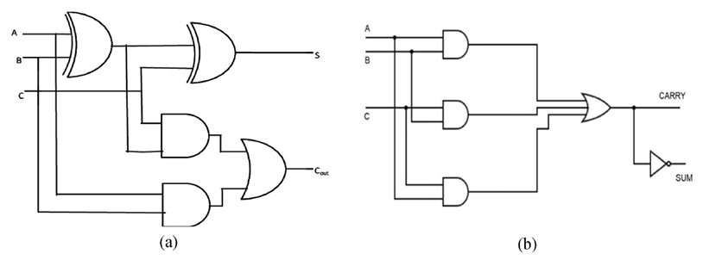
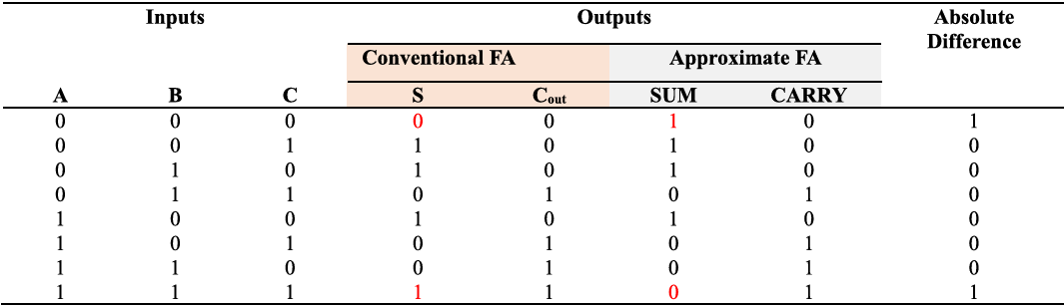
Fig 4. (a). Exact HA, (b). Approx. HA
table. 1. Exact vs Approximate HA truth table comparison
Fig 5. (a). Exact FA, (b). Approx. FA
table. 2. Exact vs Approximate FA truth table comparison

Slide 10
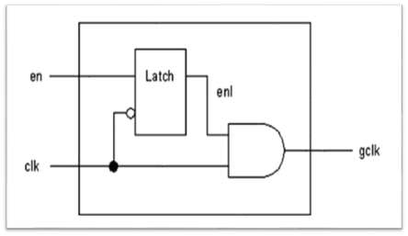
Adder Architectures and Design Flow
Partial product generation is performed using AND gate arrays in the multiplier.
Accumulation of partial products is implemented using different adder architectures: Ripple Carry Adder (RCA), Carry Save Adder (CSA), Carry Select Adder (CSLA) and Carry Skip Adder (COSA)
Approximate adders replace exact adders in lower bit positions (LSBs) to reduce power, area, and delay, while exact adders are retained in higher bit positions (MSBs) for accuracy.
Clock gating circuitry with enable control signals deactivates unused computation blocks, minimizing dynamic power consumption.
Both signed - unsigned multiplier versions are designed and analysed for performance, accuracy, & energy efficiency.
The combined use of approximate arithmetic + clock gating enables the design of low‑power, error‑tolerant multipliers.
Fig 6. Integrated clock gating circuit.

Slide 11
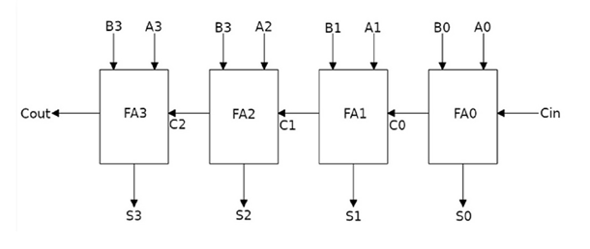
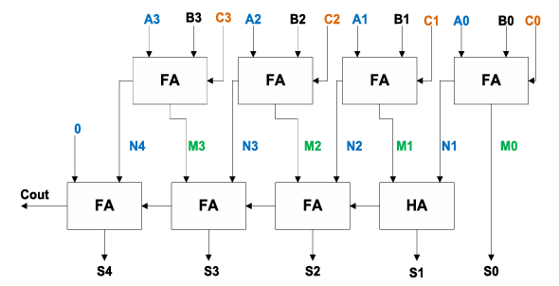
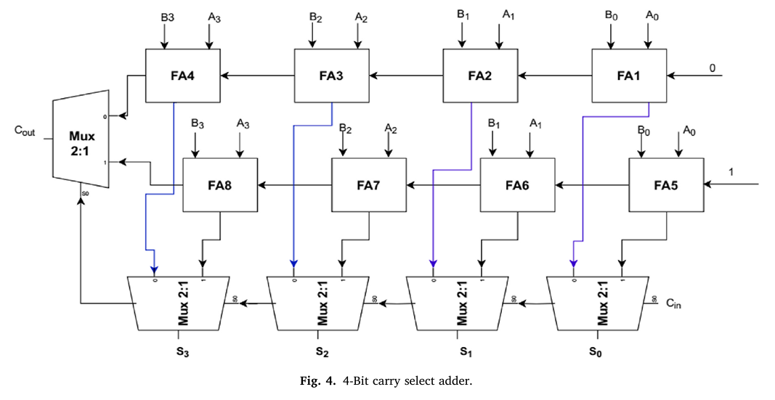
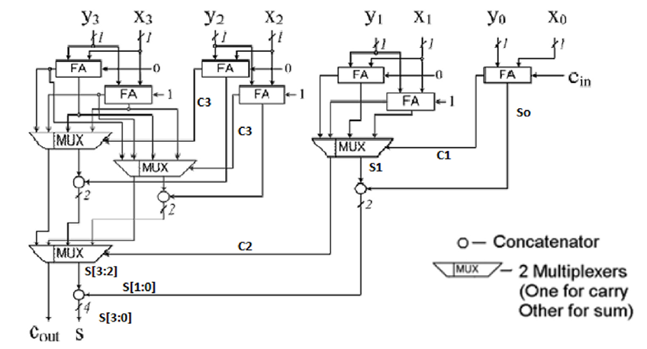
Fig 7. 4-Bit ripple carry adder (RCA)
Fig 8. 4-Bit carry save adder (CSA)
Fig 9. 4-Bit carry select adder (CSLA)
Fig 10. 4-Bit conditional sum adder (COSA)

Slide 12
Clock-Gated Approximate Multiplier Architecture (4-bit to 16-bit)
4-bit Approximate Multiplier: Partial products are generated using AND gates. Approximate Half Adders (AHA) and Approximate Full Adders (AFA) are used in the LSB region, while exact adders (RCA / CSA / CSLA / COSA) are retained in the MSB region.
8-bit Approximate Multiplier: Built using four 4-bit approximate multipliers. Intermediate partial products are aligned and accumulated using an 8-bit adder, enabling hierarchical and modular expansion.
16-bit Approximate Multiplier: Constructed using four 8-bit approximate multipliers. Their outputs are combined through a 16-bit adder, where MSB accuracy is preserved and LSB approximation is controlled.
Clock Gating: A latch-based clock gating circuit enables the clock only when computation is required, disabling registers and adder blocks during idle periods.
Overall Functioning (Final 16-bit Operation):
When enable = 1, the gated clock activates the multiplier blocks and registers. Partial products are generated, approximated in lower bits, and accumulated through hierarchical adders. The final product is registered on the gated clock edge.
When enable = 0, the clock is blocked, and the output is held constant, eliminating unnecessary switching and reducing dynamic power consumption.

Slide 13
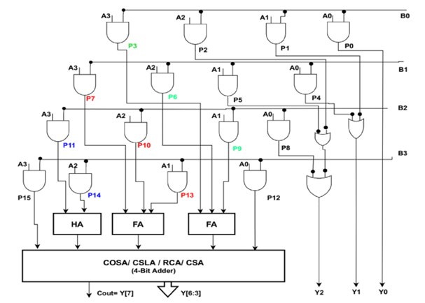
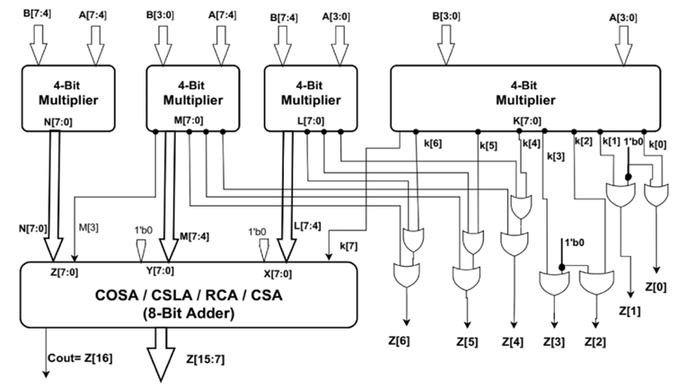
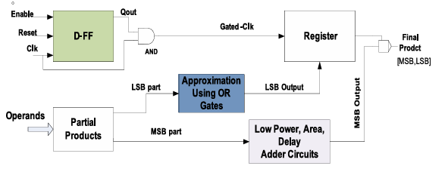
Fig 11. Architecture of 4-bit approximate multiplier.
Fig 12. Approximate Multiplier block diagram with clock enabled Register.
Fig 13. The architecture of 8-bit approx. multiplier using 4-bit multipliers.

Slide 14
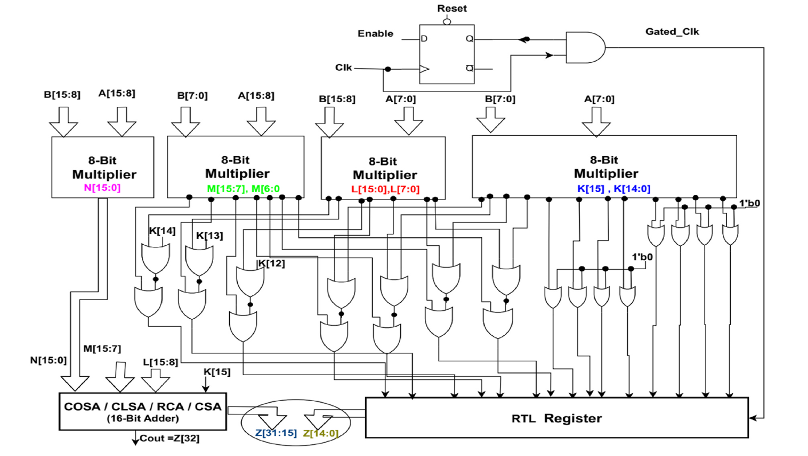
Fig 14. The architecture of a 16-bit approximate multiplier using an 8-bit multiplier and clock gating

Slide 15
Result Analysis (Evaluation Framework, Performance, Accuracy & Final Outcomes)

Slide 16
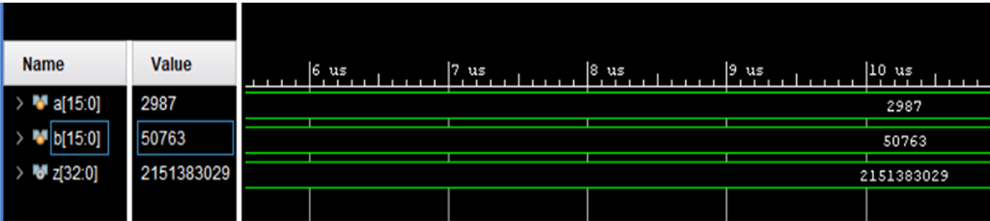
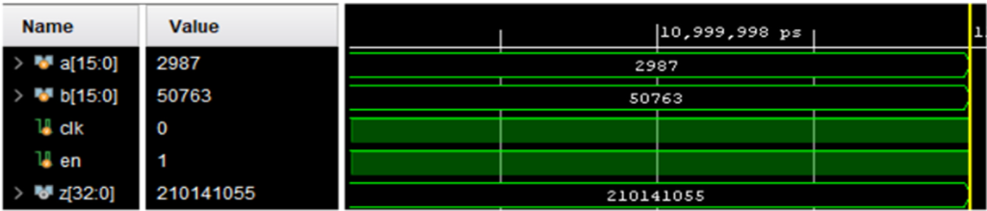
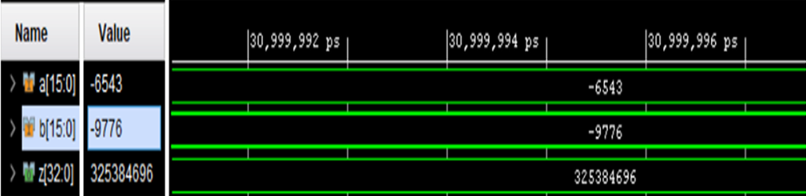
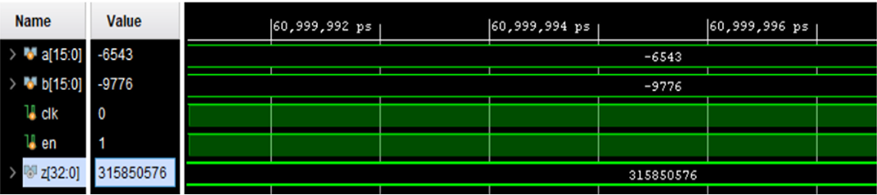
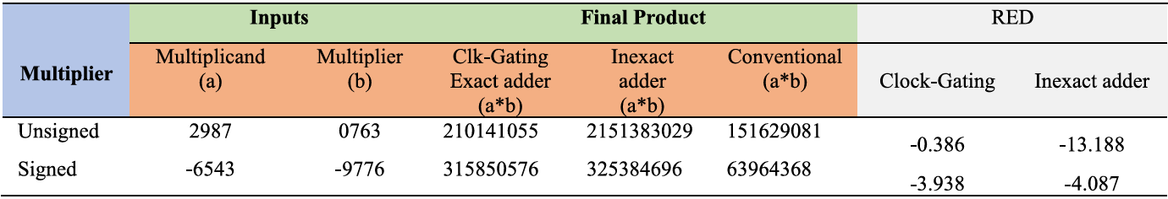
Fig. 15. 16-bit Unsigned and Signed Approximate Multiplier output with approximate adders
Fig. 16. 16-bit Unsigned and Signed Approximate Multiplier output with clock-gating and exact adders
table. 3. Approximate Multiplier accuracy determination

Slide 17
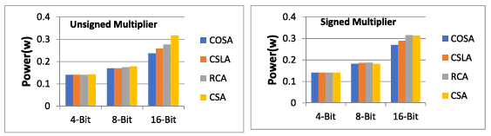
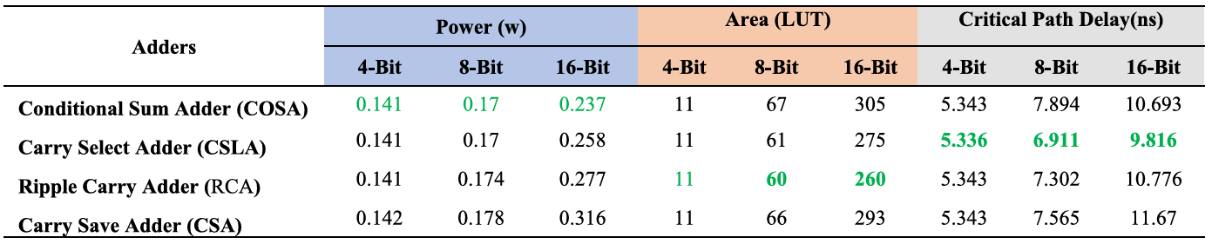
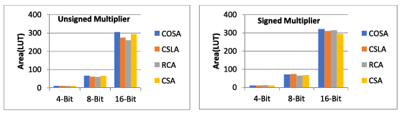
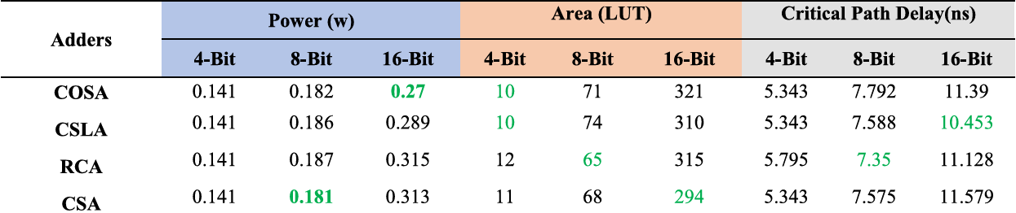
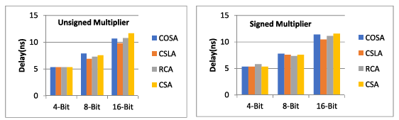
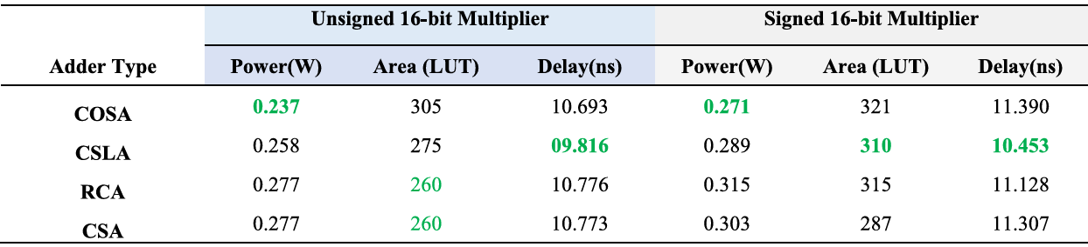
Fig. 17. Approximate multipliers Power characteristics comparison
Table 4. Unsigned Approximate Multiplier parameters
Fig. 18. Approximate multipliers Area characteristics comparison
Table 5. Signed Approximate Multiplier parameters
Fig. 19. Approximate multipliers Delay characteristics comparison
Table. 6. 16-bit Approx. Multiplier using Clock Gating and Exact Adders

Slide 18
Adder-wise Performance
RCA-based multiplier - Lowest hardware area due to simple structure and Moderate delay caused by serial carry propagation.
CSA-based multiplier - Reduced delay compared to RCA by parallel carry handling with slight increase in area.
CSLA-based multiplier - Lowest propagation delay due to parallel carry computation and higher area overhead.
COSA-based multiplier - Best power efficiency by minimizing unnecessary switching activity with balanced delay and area.
Overall Observations
Clock gating effectively reduces dynamic power across all multiplier architectures.
Approximation applied only in the LSB region preserves MSB accuracy.
Error Rate and Mean Error Distance stay within acceptable bounds.
Power savings are achieved with negligible degradation in delay and area.
The proposed designs provide a balanced power–delay–area trade-off suitable for low-power applications.

Slide 19
Conclusions
A low-power multiplier is designed using approximate computing and clock gating.
Approximate HAs and FAs reduce hardware complexity in the LSB region.
Clock gating effectively lowers switching activity and dynamic power.
RCA, CSA, CSLA, and COSA architectures are analyzed to study trade-offs.
Significant power reduction is achieved with minimal delay and area overhead.
The design maintains acceptable accuracy, suitable for Digital signal & image processing and multimedia applications.
Future Scope
Implementation using ASIC design flow for real-time deployment and detailed power analysis.
Development of adaptive approximation with dynamic accuracy control.
Extension to higher bit-width multipliers and other arithmetic units (ALUs, dividers).
Application in image processing, video compression, and ML accelerators.
Integration with advanced low-power techniques such as voltage scaling and power gating.
Exploration of automated design methods for optimal power–accuracy trade-offs.

Slide 20
References
[1] V. S. Chowdam et al., “Design of clock-gated approximate multipliers for power efficient applications,” Memories – Materials, Devices, Circuits and Systems, vol. 9, Art. no. 100123, 2025.
[2] S. Mittal, “A survey of techniques for approximate computing,” ACM Computing Surveys, vol. 48, no. 4, pp. 1–33, 2016.
[3] J. M. Rabaey, A. Chandrakasan, and B. Nikolic, Digital Integrated Circuits: A Design Perspective, 2nd ed. Upper Saddle River, NJ, USA: Prentice Hall, 2003.
[4] M. Pedram and J. M. Rabaey, Power Aware Design Methodologies. New York, NY, USA: Springer, 2002.
[5] N. H. E. Weste and D. Harris, CMOS VLSI Design: A Circuits and Systems Perspective, 4th ed. Boston, MA, USA: Pearson Education, 2011.
[6] J. Han and M. Orshansky, “Approximate computing: An emerging paradigm for energy-efficient design,” in Proc. IEEE European Test Symposium (ETS), Avignon, France, 2013, pp. 1–6.
[7] S. Venkatachalam and S.-B. Ko, “Design of power and area efficient approximate multipliers,” IEEE Trans. Very Large Scale Integr. (VLSI) Syst., vol. 25, no. 5, pp. 1782–1792, May 2017.
[8] A. Vignesh and R. Dhavse, “Design of high accuracy, power efficient and area efficient 16×16 approximate multiplier,” in Proc. IEEE INDICON, New Delhi, India, 2020.
[9] V. Gupta, D. Mohapatra, A. Raghunathan, and K. Roy, “Low-power digital signal processing using approximate adders,” IEEE Trans. Comput.-Aided Design Integr. Circuits Syst., vol. 32, no. 1, pp. 124–137, Jan. 2013

Slide 21
THANK YOU
Any questions ?

